Slide 1
Week 03 What have I learned Jiri Vana

Slide 2
NOTHING

Slide 3
Thank You
EXCEPTION UNHANDLED

Slide 4
Project analysis slide 2
WeekThree
FILE MANIPULATION
EXCEPTIONS
C#
ReadAllLines()
ReadAllText()
WriteAllLines()
WriteAllText()
…etc.
try
catch
throw
finally
…etc.

Slide 5
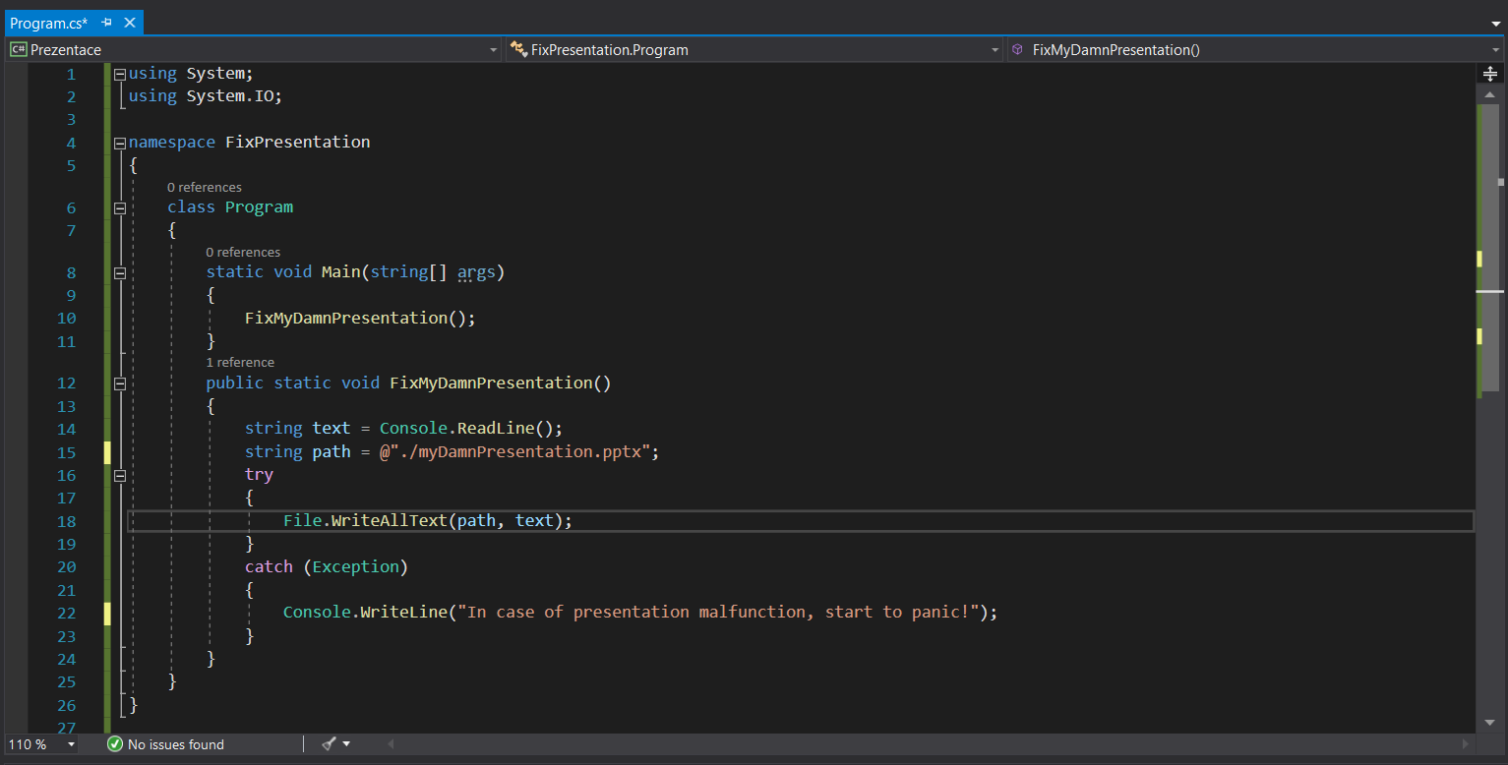
Simple file manipulation
Exceptions

Slide 6
Project analysis slide 5
SmartMeter

Slide 7
CLASSES
FIELDS
ENCAPSULATION
PROPERTIES
CONSTRUCTOR
CLASSES
DATA STRUCTURE

Slide 8
Project analysis slide 2
class WeekThree
ENCAPSULATION
CLASSES
C#
DATA STRUCTURE
FIELDS
PROPERTIES
CONSTRUCTOR

Slide 9
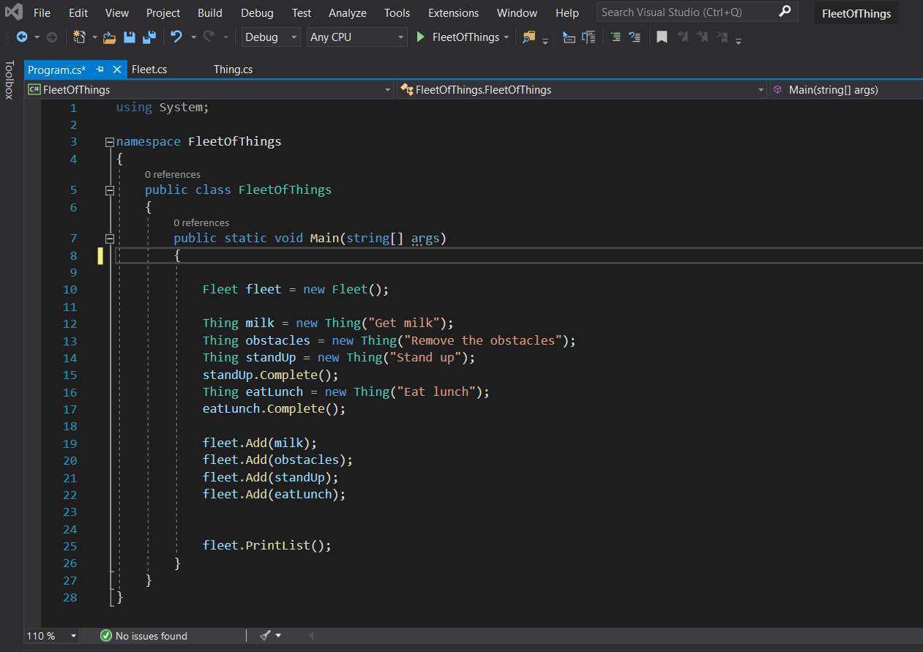
1. Create the things
2. Add them into the list

Slide 10
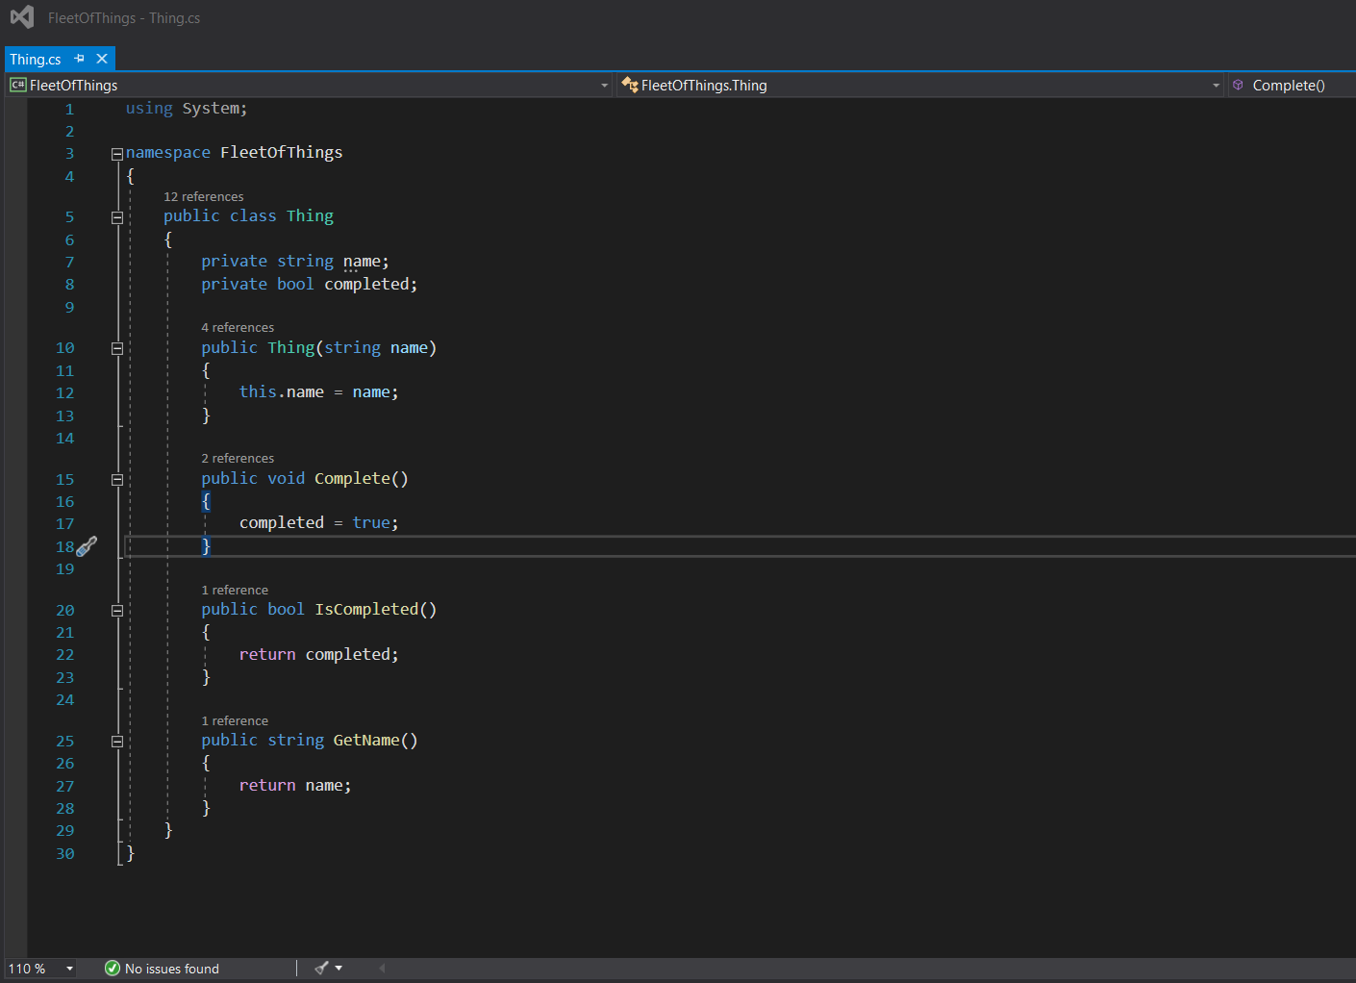
3. IsCompleted method
4. GetName method

Slide 11
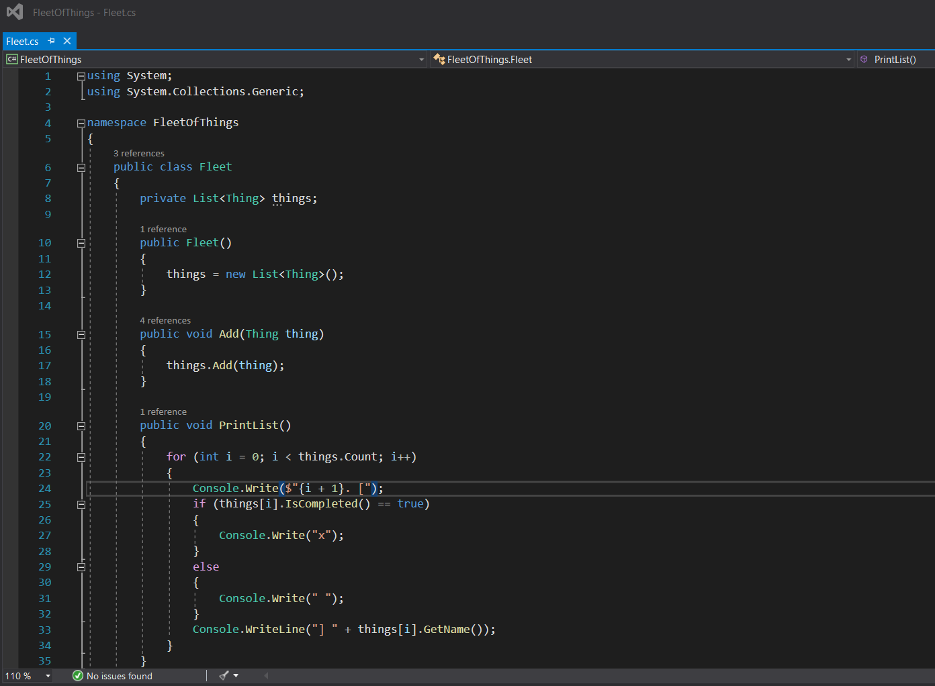
5. Create PrintList method
DONE

Slide 12
Project analysis slide 5
class SmartMeter
On the bright side – I didn’t know any of this just a few days ago

Slide 13
Thank You (for real)

